Slide 1

NCKU Programming Contest Training Course
2018/05/09
Jheng-Huang Hong
Department of Computer Science and Information Engineering
National Cheng Kung University
Tainan, Taiwan

Slide 2
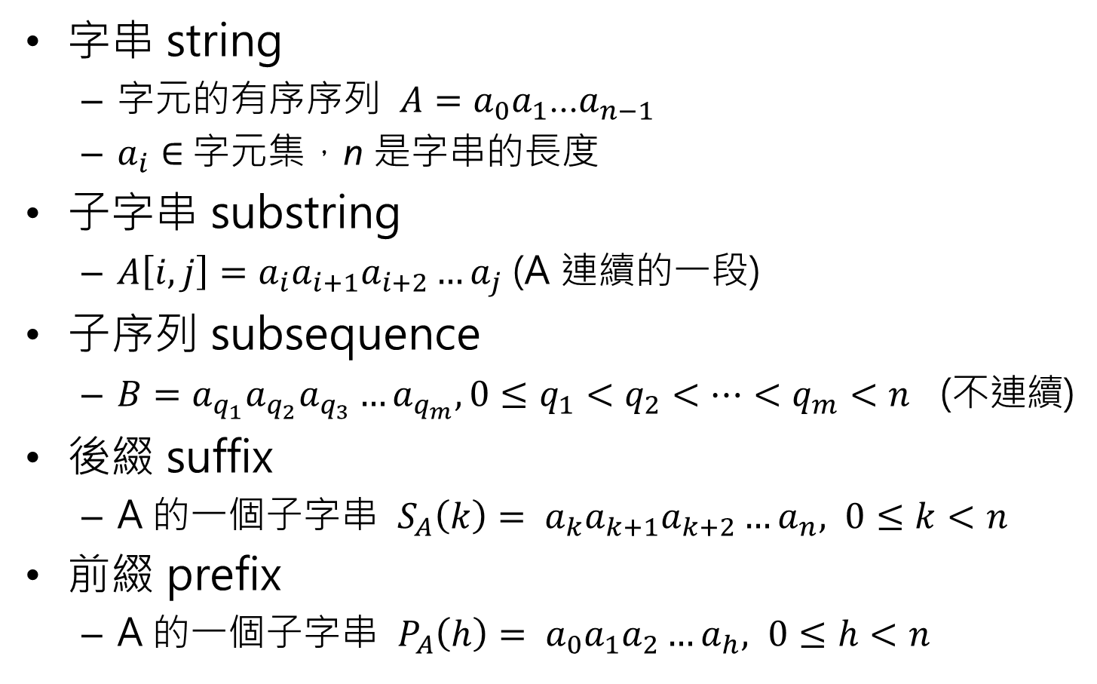
String Basic
字串 string
字元的有序序列 $A=a_{0}a_{1}$…$a_{n−1}$
$a_{i}∈$字元集，n 是字串的長度
子字串 substring
$A\left[i,j\right]=a_{i}a_{i+1}a_{i+2}…a_{j}$ (A 連續的一段)
子序列 subsequence
$B=a_{q_{1}}a_{q_{2}}a_{q_{3}}…a_{q_{m}}, 0≤q_{1}<q_{2}<…<q_{m}<n$ (不連續)
後綴 suffix
A 的一個子字串 $S_{A}\left(k\right)= a_{k}a_{k+1}a_{k+2}…a_{n}, 0≤k<n$
前綴 prefix
A 的一個子字串 $P_{A}\left(h\right)= a_{0}a_{1}a_{2}…a_{h}, 0≤h<n$

Slide 3
String Basic
S =“abcbbab”
子字串： “bcb”,“bba”, …
子序列： “acb”,“bbb”, …
前綴： “abcb”,“ab”, …
後綴： “bbab”,“ab”, …

Slide 4
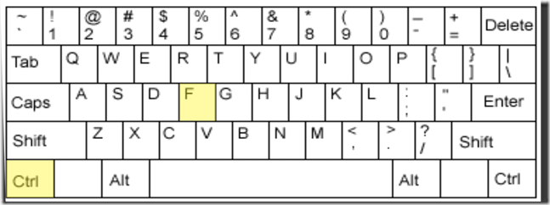
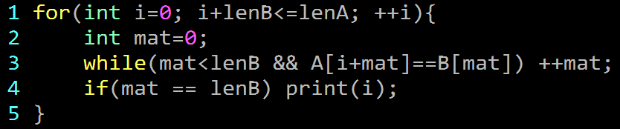

String Matching
給兩個字串 A, B 找出所有 B 出現在 A 中的位置
複雜度：$𝒪\left(\left|A\right|\right)$
A = “abcdefg” B = “cde”
a | b | c | d | e | f | g
c | d | e

Slide 5
String Matching
給兩個字串 A, B 找出所有 B 出現在 A 中的位置
複雜度：$𝒪\left(\left|A\right|\right)$
A = “abcdefg” B = “cde”
a | b | c | d | e | f | g
 | c | d | e

Slide 6
String Matching
給兩個字串 A, B 找出所有 B 出現在 A 中的位置
複雜度：$𝒪\left(\left|A\right|\right)$
A = “abcdefg” B = “cde”
a | b | c | d | e | f | g
 |  | c | d | e

Slide 7
String Matching
給兩個字串 A, B 找出所有 B 出現在 A 中的位置
複雜度：$𝒪\left(\left|A\right|\right)$
A = “abcdefg” B = “cde”
a | b | c | d | e | f | g
 |  | c | d | e

Slide 8

String Matching
給兩個字串 A, B 找出所有 B 出現在 A 中的位置
複雜度：$𝒪\left(\left|A\right|\right)$
A = “abcdefg” B = “cde”
Matching!!
a | b | c | d | e | f | g
 |  | c | d | e

Slide 9
String Matching
給兩個字串 A, B 找出所有 B 出現在 A 中的位置
複雜度：$𝒪\left(\left|A\right|\right)$
A = “abcdefg” B = “cde”
a | b | c | d | e | f | g
 |  |  | c | d | e

Slide 10
String Matching
給兩個字串 A, B 找出所有 B 出現在 A 中的位置
複雜度：$𝒪\left(\left|A\right|\right)$
A = “abcdefg” B = “cde”
a | b | c | d | e | f | g
 |  |  |  | c | d | e

Slide 11

String Matching
給兩個字串 A, B 找出所有 B 出現在 A 中的位置
複雜度：$𝒪\left(\left|A\right|\right)$
A = “aaaaaaa…aaa” B = “aaaaaaa…aab”
a | a | a | a | a | a
a | a | a | b

Slide 12
String Matching
給兩個字串 A, B 找出所有 B 出現在 A 中的位置
複雜度：$𝒪\left(\left|A\right|\right)$
A = “aaaaaaa…aaa” B = “aaaaaaa…aab”
a | a | a | a | a | a
a | a | a | b

Slide 13
String Matching
給兩個字串 A, B 找出所有 B 出現在 A 中的位置
複雜度：$𝒪\left(\left|A\right|\right)$
A = “aaaaaaa…aaa” B = “aaaaaaa…aab”
a | a | a | a | a | a
a | a | a | b

Slide 14
String Matching
給兩個字串 A, B 找出所有 B 出現在 A 中的位置
複雜度：$𝒪\left(\left|A\right|\right)$
A = “aaaaaaa…aaa” B = “aaaaaaa…aab”
a | a | a | a | a | a
a | a | a | b

Slide 15
String Matching
給兩個字串 A, B 找出所有 B 出現在 A 中的位置
複雜度：$𝒪\left(\left|A\right|\right)$
A = “aaaaaaa…aaa” B = “aaaaaaa…aab”
a | a | a | a | a | a
 | a | a | a | b

Slide 16
String Matching
給兩個字串 A, B 找出所有 B 出現在 A 中的位置
複雜度：$𝒪\left(\left|A\right|\right)$
A = “aaaaaaa…aaa” B = “aaaaaaa…aab”
a | a | a | a | a | a
 | a | a | a | b

Slide 17
String Matching
給兩個字串 A, B 找出所有 B 出現在 A 中的位置
複雜度：$𝒪\left(\left|A\right|\right)$
A = “aaaaaaa…aaa” B = “aaaaaaa…aab”
a | a | a | a | a | a
 | a | a | a | b

Slide 18
String Matching
給兩個字串 A, B 找出所有 B 出現在 A 中的位置
複雜度：$𝒪\left(\left|A\right|\right)$
A = “aaaaaaa…aaa” B = “aaaaaaa…aab”
a | a | a | a | a | a
 | a | a | a | b

Slide 19
String Matching
給兩個字串 A, B 找出所有 B 出現在 A 中的位置
複雜度：$𝒪\left(\left|A\right|\right)$
A = “aaaaaaa…aaa” B = “aaaaaaa…aab”
a | a | a | a | a | a
 |  | a | a | a | b

Slide 20
String Matching
給兩個字串 A, B 找出所有 B 出現在 A 中的位置
複雜度：$𝒪\left(\left|A\right|\right)$
A = “aaaaaaa…aaa” B = “aaaaaaa…aab”
a | a | a | a | a | a
 |  | a | a | a | b

Slide 21
String Matching
給兩個字串 A, B 找出所有 B 出現在 A 中的位置
複雜度：$𝒪\left(\left|A\right|\right)$
A = “aaaaaaa…aaa” B = “aaaaaaa…aab”
a | a | a | a | a | a
 |  | a | a | a | b

Slide 22

String Matching
給兩個字串 A, B 找出所有 B 出現在 A 中的位置
複雜度：$𝒪\left(\left|A\right|\right) 𝒪\left(\left|A\right|\left|B\right|\right)$
A = “aaaaaaa…aaa” B = “aaaaaaa…aab”
a | a | a | a | a | a
 |  | a | a | a | b

Slide 23
Outline
Hashing
KMP
AC Automaton

Slide 24
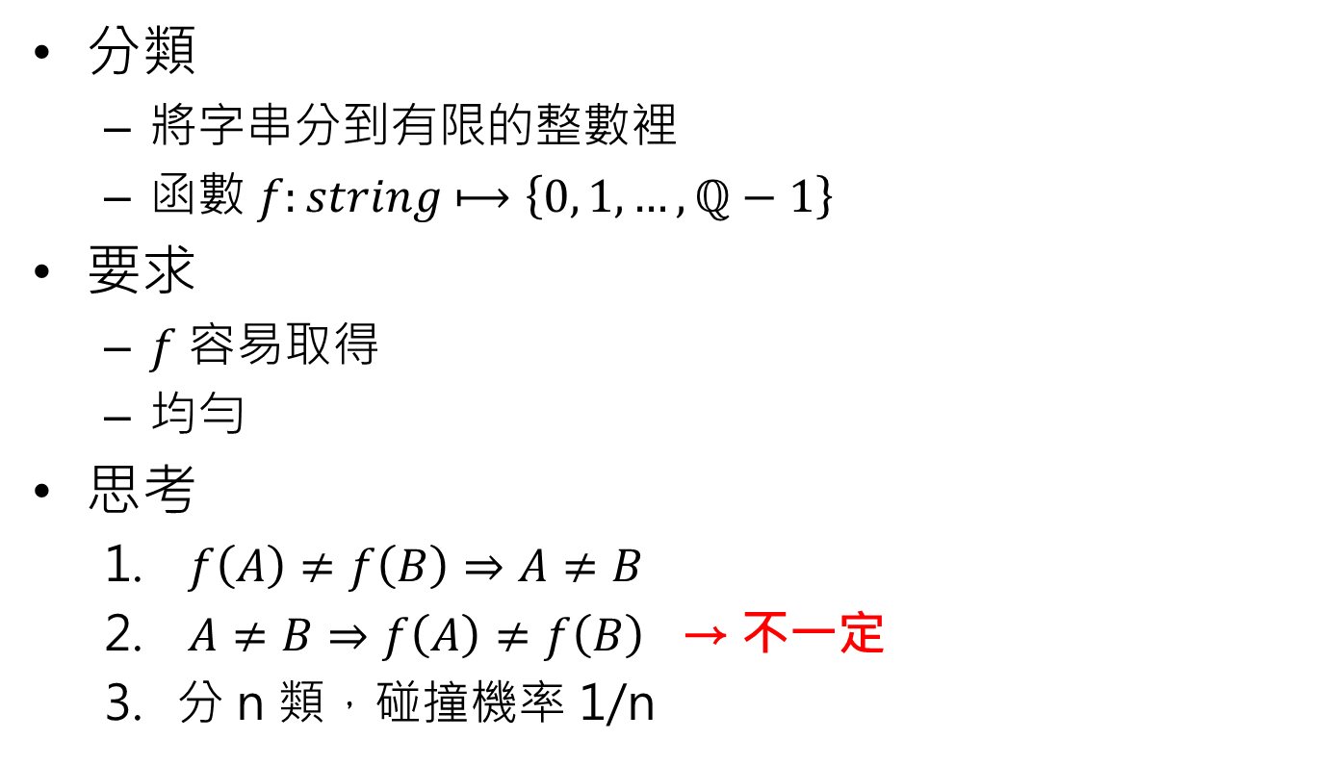
Hashing
分類
將字串分到有限的整數裡
函數 $f:string⟼\left\{0, 1, …, ℚ−1\right\}$
要求
$f$ 容易取得
均勻
思考
$f\left(A\right)≠f\left(B\right)⇒A≠B$
$A≠B⇒f\left(A\right)≠f\left(B\right)$ → 不一定
分 n 類，碰撞機率 1/n

Slide 25
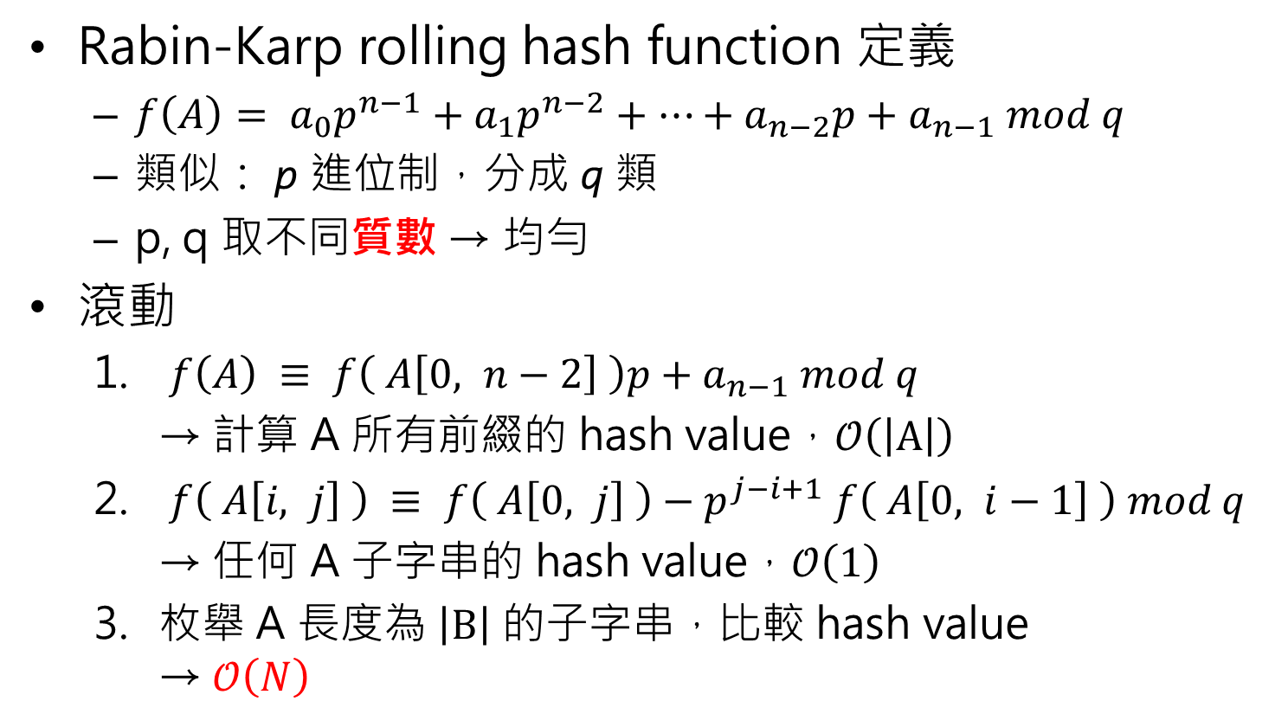
Hashing
Rabin-Karp rolling hash function 定義
$f\left(A\right)= a_{0}p^{n−1}+a_{1}p^{n−2}+…+a_{n−2}p+a_{n−1} mod q$
類似： p 進位制，分成 q 類
p, q 取不同質數 → 均勻
滾動
$f\left(A\right) ≡ f\left( A\left[0, n−2\right] \right)p+a_{n−1} mod q$
→ 計算 A 所有前綴的 hash value，$𝒪\left(\left|A\right|\right)$
$f\left( A\left[i, j\right] \right) ≡ f\left( A\left[0, j\right] \right)−p^{j−i+1} f\left( A\left[0, i−1\right] \right) mod q$
→ 任何 A 子字串的 hash value，$𝒪\left(1\right)$
枚舉 A 長度為 $\left|B\right|$ 的子字串，比較 hash value → $𝒪\left(N\right)$

Slide 26

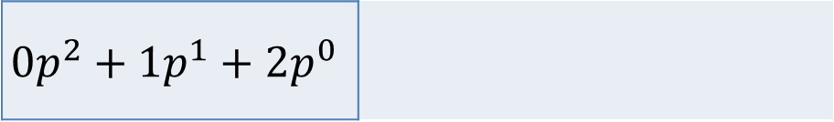
Hashing
A = “abcdefg”
B = “cde”= $2p^{2}+3p^{1}+4p^{0}$
a | b | c | d | e | f | g
$$0p^{2}+1p^{1}+2p^{0}$$

Slide 27

Hashing
A = “abcdefg”
B = “cde”= $2p^{2}+3p^{1}+4p^{0}$
a | b | c | d | e | f | g
 | $$1p^{2}+2p^{1}+3p^{0}$$

Slide 28


Hashing
A = “abcdefg”
B = “cde”= $2p^{2}+3p^{1}+4p^{0}$
a | b | c | d | e | f | g
 |  | $$2p^{2}+3p^{1}+4p^{0}$$
Matching!!

Slide 29

Hashing
A = “abcdefg”
B = “cde”= $2p^{2}+3p^{1}+4p^{0}$
a | b | c | d | e | f | g
 |  |  | $$3p^{2}+4p^{1}+5p^{0}$$

Slide 30
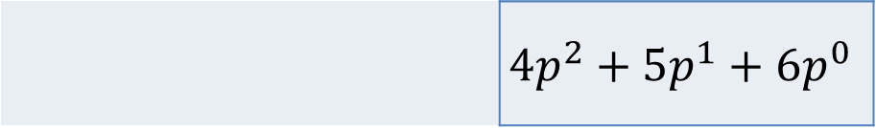
Hashing
A = “abcdefg”
B = “cde”= $2p^{2}+3p^{1}+4p^{0}$
a | b | c | d | e | f | g
 |  |  |  | $$4p^{2}+5p^{1}+6p^{0}$$

Slide 31
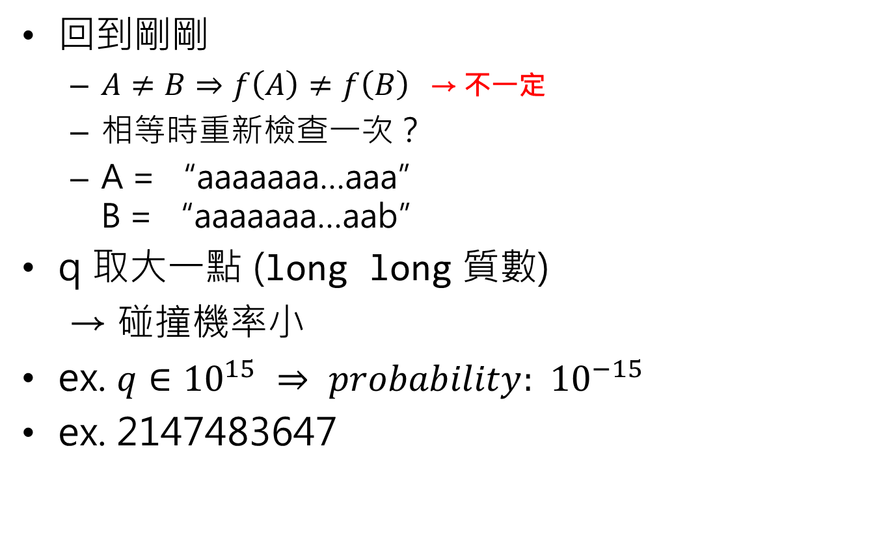
Hashing
回到剛剛
$A≠B⇒f\left(A\right)≠f\left(B\right)$ → 不一定
相等時重新檢查一次？
A = “aaaaaaa…aaa” B = “aaaaaaa…aab”
q 取大一點 (long long 質數)
→ 碰撞機率小
ex. $q∈{10}^{15} ⇒ probability: { 10}^{−15}$
ex. 2147483647

Slide 32
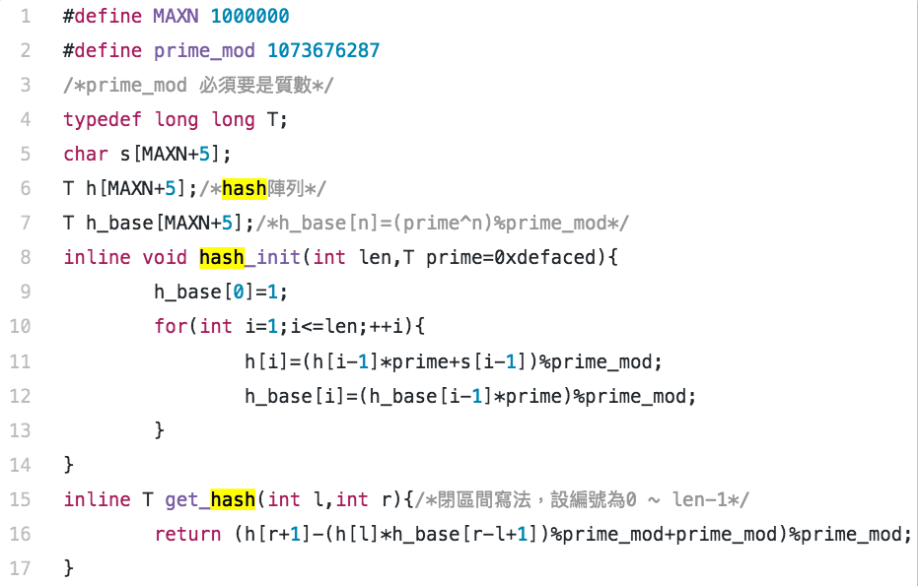
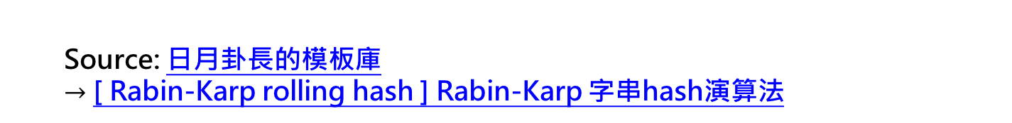
Hashing – 參考
Source: 日月卦長的模板庫 $→$ [ Rabin-Karp rolling hash ] Rabin-Karp 字串hash演算法

Slide 33
Outline
Hashing
KMP
AC Automaton

Slide 34
KMP
Knuth-Morris-Pratt algorithm
再來看個例子 a = “aabaac…” b = “aabaab”
a | a | b | a | a | c | ? | ? | …
a | a | b | a | a | b

Slide 35
KMP
Knuth-Morris-Pratt algorithm
再來看個例子 a = “aabaac…” b = “aabaab”
a | a | b | a | a | c | ? | ? | …
a | a | b | a | a | b

Slide 36
KMP
Knuth-Morris-Pratt algorithm
再來看個例子 a = “aabaac…” b = “aabaab”
a | a | b | a | a | c | ? | ? | …
 | a | a | b | a | a | b

Slide 37
KMP
Knuth-Morris-Pratt algorithm
再來看個例子 a = “aabaac…” b = “aabaab”
a | a | b | a | a | c | ? | ? | …
 |  | a | a | b | a | a | b

Slide 38
KMP
Knuth-Morris-Pratt algorithm
再來看個例子 a = “aabaac…” b = “aabaab”
重複匹配失敗
a | a | b | a | a | c | ? | ? | …
 |  | a | a | b | a | a | b

Slide 39
KMP
Knuth-Morris-Pratt algorithm
再來看個例子 a = “aabaac…” b = “aabaab”
a | a | b | a | a | c | ? | ? | …
a | a | b | a | a | b

Slide 40
KMP
Knuth-Morris-Pratt algorithm
再來看個例子 a = “aabaac…” b = “aabaab”
a | a | b | a | a | c | ? | ? | …
 |  |  | a | a | b | a | a | b
直接往右移3格
早就可以知道他們一樣

Slide 41
KMP
Knuth-Morris-Pratt algorithm
再來看個例子 a = “aabaac…” b = “aabaab”
a | a | b | a | a | c | ? | ? | …
 |  |  | a | a | b | a | a | b
直接往右移3格
問題出在 B 有重複子字串

Slide 42
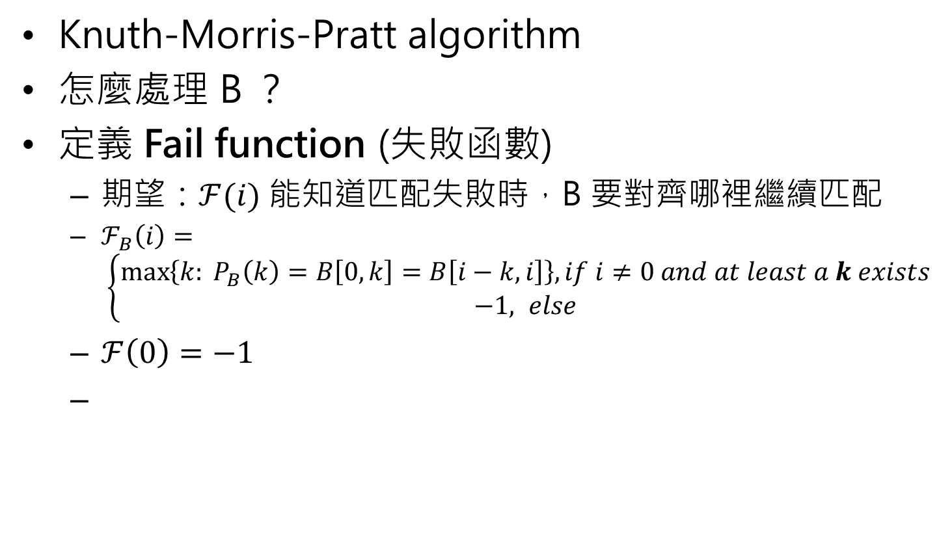

KMP
Knuth-Morris-Pratt algorithm
怎麼處理 B ？
定義 Fail function (失敗函數)
期望：$ℱ(i)$ 能知道匹配失敗時，B 要對齊哪裡繼續匹配
$ℱ_{B}\left(i\right)= \left\{\begin{aligned}\max\left\{k: P_{B}\left(k\right)=B\left[0,k\right]=B\left[i−k,i\right]\right\}, if i≠0 and at least a k exists \\ −1, else\end{aligned}\right.$
$ℱ\left(0\right)=−1$
$𝓕(5)$：給我對齊B[2]!!
a | a | b | a | a | c | ? | ? | …
a | a | b | a | a | b

Slide 43
KMP
Knuth-Morris-Pratt algorithm
怎麼處理 B ？
定義 Fail function (失敗函數)
期望：$ℱ(i)$ 能知道匹配失敗時，B 要對齊哪裡繼續匹配
$ℱ_{B}\left(i\right)= \left\{\begin{aligned}\max\left\{k: P_{B}\left(k\right)=B\left[0,k\right]=B\left[i−k,i\right]\right\}, if i≠0 and at least a k exists \\ −1, else\end{aligned}\right.$
$ℱ\left(0\right)=−1$
B[2]：來了…
a | a | b | a | a | c | ? | ? | …
 |  |  | a | a | b | a | a | b

Slide 44
KMP
Fail function example
i |  | 0 | 1 | 2 | 3 | 4 | 5 | 6 | 7 | 8
B |  | a | b | z | a | b | z | a | b | c
pi |  | -1
init:
pi[0]=-1
cur_pos=-1

Slide 45
KMP
Fail function example
i |  | 0 | 1 | 2 | 3 | 4 | 5 | 6 | 7 | 8
B |  | a | b | z | a | b | z | a | b | c
pi |  | -1 | -1
B[cur_pos+1]!=B[i]
pi[i]=cur_pos

Slide 46
KMP
Fail function example
i |  | 0 | 1 | 2 | 3 | 4 | 5 | 6 | 7 | 8
B |  | a | b | z | a | b | z | a | b | c
pi |  | -1 | -1 | -1
B[cur_pos+1]!=B[i]
pi[i]=cur_pos

Slide 47
KMP
Fail function example
i |  | 0 | 1 | 2 | 3 | 4 | 5 | 6 | 7 | 8
B |  | a | b | z | a | b | z | a | b | c
pi |  | -1 | -1 | -1 | 0
B[cur_pos+1]==B[i]
pi[i]=++cur_pos

Slide 48
KMP
Fail function example
i |  | 0 | 1 | 2 | 3 | 4 | 5 | 6 | 7 | 8
B |  | a | b | z | a | b | z | a | b | c
pi |  | -1 | -1 | -1 | 0 | 1
B[cur_pos+1]==B[i]
pi[i]=++cur_pos

Slide 49
KMP
Fail function example
i |  | 0 | 1 | 2 | 3 | 4 | 5 | 6 | 7 | 8
B |  | a | b | z | a | b | z | a | b | c
pi |  | -1 | -1 | -1 | 0 | 1 | 2
B[cur_pos+1]==B[i]
pi[i]=++cur_pos

Slide 50
KMP
Fail function example
i |  | 0 | 1 | 2 | 3 | 4 | 5 | 6 | 7 | 8
B |  | a | b | z | a | b | z | a | b | c
pi |  | -1 | -1 | -1 | 0 | 1 | 2 | 3
B[cur_pos+1]==B[i]
pi[i]=++cur_pos

Slide 51
KMP
Fail function example
i |  | 0 | 1 | 2 | 3 | 4 | 5 | 6 | 7 | 8
B |  | a | b | z | a | b | z | a | b | c
pi |  | -1 | -1 | -1 | 0 | 1 | 2 | 3 | 4
B[cur_pos+1]==B[i]
pi[i]=++cur_pos

Slide 52
KMP
Fail function example
i |  | 0 | 1 | 2 | 3 | 4 | 5 | 6 | 7 | 8
B |  | a | b | z | a | b | z | a | b | c
pi |  | -1 | -1 | -1 | 0 | 1 | 2 | 3 | 4 | 1
B[cur_pos+1]!=B[i]
pi[i]=pi[cur_pos]

Slide 53
KMP
Fail function example
i |  | 0 | 1 | 2 | 3 | 4 | 5 | 6 | 7 | 8
B |  | a | b | z | a | b | z | a | b | c
pi |  | -1 | -1 | -1 | 0 | 1 | 2 | 3 | 4 | -1
B[cur_pos+1]!=B[i]
pi[i]=pi[cur_pos]

Slide 54
KMP
Fail function
inline void fail (char *B, int *pi) {
int len = strlen(B);
pi[0] = -1;
for(int i=1, cur_pos=-1; i<len; ++i) {
while(~cur_pos && B[i]!=B[cur_pos+1])
cur_pos = pi[cur_pos];
if(B[i]==B[cur_pos+1]) ++cur_pos;
pi[i] = cur_pos;
}
}

Slide 55
KMP
Matching
Fail function: 找出各後綴與前綴一樣的最大值
如果後綴 = 前綴 → 可直接位移
prefix |  |  |  | suffix

Slide 56
KMP
Matching
Fail function: 找出各後綴與前綴一樣的最大值
如果後綴 = 前綴 → 可直接位移
prefix |  |  |  | suffix

Slide 57
KMP
Matching
A |  |  | x | a | b | z | a | b | z | a | b | z | a | b | c | d
init:
cur_pos = -1
cur_pos
 |  | -1 | 0 | 1 | 2 | 3 | 4 | 5 | 6 | 7 | 8
B |  |  | a | b | z | a | b | z | a | b | c
pi |  |  | -1 | -1 | -1 | 0 | 1 | 2 | 3 | 4 | -1

Slide 58
KMP
Matching
i
A |  |  | x | a | b | z | a | b | z | a | b | z | a | b | c | d
A[i]!=B[cur_pos+1]
cur_pos
 |  | -1 | 0 | 1 | 2 | 3 | 4 | 5 | 6 | 7 | 8
B |  |  | a | b | z | a | b | z | a | b | c
pi |  |  | -1 | -1 | -1 | 0 | 1 | 2 | 3 | 4 | -1

Slide 59
KMP
Matching
i
A |  |  | x | a | b | z | a | b | z | a | b | z | a | b | c | d
A[i]==B[cur_pos+1]
++cur_pos
cur_pos
 |  | -1 | 0 | 1 | 2 | 3 | 4 | 5 | 6 | 7 | 8
B |  |  | a | b | z | a | b | z | a | b | c
pi |  |  | -1 | -1 | -1 | 0 | 1 | 2 | 3 | 4 | -1

Slide 60
KMP
Matching
i
A |  |  | x | a | b | z | a | b | z | a | b | z | a | b | c | d
A[i]==B[cur_pos+1]
++cur_pos
cur_pos
 |  | -1 | 0 | 1 | 2 | 3 | 4 | 5 | 6 | 7 | 8
B |  |  | a | b | z | a | b | z | a | b | c
pi |  |  | -1 | -1 | -1 | 0 | 1 | 2 | 3 | 4 | -1

Slide 61
KMP
Matching
i
A |  |  | x | a | b | z | a | b | z | a | b | z | a | b | c | d
A[i]==B[cur_pos+1]
++cur_pos
cur_pos
 |  | -1 | 0 | 1 | 2 | 3 | 4 | 5 | 6 | 7 | 8
B |  |  | a | b | z | a | b | z | a | b | c
pi |  |  | -1 | -1 | -1 | 0 | 1 | 2 | 3 | 4 | -1

Slide 62
KMP
Matching
i
A |  |  | x | a | b | z | a | b | z | a | b | z | a | b | c | d
A[i]==B[cur_pos+1]
++cur_pos
cur_pos
 |  | -1 | 0 | 1 | 2 | 3 | 4 | 5 | 6 | 7 | 8
B |  |  | a | b | z | a | b | z | a | b | c
pi |  |  | -1 | -1 | -1 | 0 | 1 | 2 | 3 | 4 | -1

Slide 63
KMP
Matching
i
A |  |  | x | a | b | z | a | b | z | a | b | z | a | b | c | d
A[i]==B[cur_pos+1]
++cur_pos
cur_pos
 |  | -1 | 0 | 1 | 2 | 3 | 4 | 5 | 6 | 7 | 8
B |  |  | a | b | z | a | b | z | a | b | c
pi |  |  | -1 | -1 | -1 | 0 | 1 | 2 | 3 | 4 | -1

Slide 64
KMP
Matching
i
A |  |  | x | a | b | z | a | b | z | a | b | z | a | b | c | d
A[i]==B[cur_pos+1]
++cur_pos
cur_pos
 |  | -1 | 0 | 1 | 2 | 3 | 4 | 5 | 6 | 7 | 8
B |  |  | a | b | z | a | b | z | a | b | c
pi |  |  | -1 | -1 | -1 | 0 | 1 | 2 | 3 | 4 | -1

Slide 65
KMP
Matching
i
A |  |  | x | a | b | z | a | b | z | a | b | z | a | b | c | d
A[i]==B[cur_pos+1]
++cur_pos
cur_pos
 |  | -1 | 0 | 1 | 2 | 3 | 4 | 5 | 6 | 7 | 8
B |  |  | a | b | z | a | b | z | a | b | c
pi |  |  | -1 | -1 | -1 | 0 | 1 | 2 | 3 | 4 | -1

Slide 66
KMP
Matching
i
A |  |  | x | a | b | z | a | b | z | a | b | z | a | b | c | d
A[i]==B[cur_pos+1]
++cur_pos
cur_pos
 |  | -1 | 0 | 1 | 2 | 3 | 4 | 5 | 6 | 7 | 8
B |  |  | a | b | z | a | b | z | a | b | c
pi |  |  | -1 | -1 | -1 | 0 | 1 | 2 | 3 | 4 | -1

Slide 67
KMP
Matching
i
A |  |  | x | a | b | z | a | b | z | a | b | z | a | b | c | d
A[i]!=B[cur_pos+1]
cur_pos=pi[cur_pos]
cur_pos
 |  | -1 | 0 | 1 | 2 | 3 | 4 | 5 | 6 | 7 | 8
B |  |  | a | b | z | a | b | z | a | b | c
pi |  |  | -1 | -1 | -1 | 0 | 1 | 2 | 3 | 4 | -1

Slide 68
KMP
Matching
i
A |  |  | x | a | b | z | a | b | z | a | b | z | a | b | c | d
A[i]==B[cur_pos+1]
++cur_pos
cur_pos
 |  | -1 | 0 | 1 | 2 | 3 | 4 | 5 | 6 | 7 | 8
B |  |  | a | b | z | a | b | z | a | b | c
pi |  |  | -1 | -1 | -1 | 0 | 1 | 2 | 3 | 4 | -1

Slide 69
KMP
Matching
i
A |  |  | x | a | b | z | a | b | z | a | b | z | a | b | c | d
A[i]==B[cur_pos+1]
++cur_pos
cur_pos
 |  | -1 | 0 | 1 | 2 | 3 | 4 | 5 | 6 | 7 | 8
B |  |  | a | b | z | a | b | z | a | b | c
pi |  |  | -1 | -1 | -1 | 0 | 1 | 2 | 3 | 4 | -1

Slide 70
KMP
Matching
i
A |  |  | x | a | b | z | a | b | z | a | b | z | a | b | c | d
A[i]==B[cur_pos+1]
++cur_pos
cur_pos
 |  | -1 | 0 | 1 | 2 | 3 | 4 | 5 | 6 | 7 | 8
B |  |  | a | b | z | a | b | z | a | b | c
pi |  |  | -1 | -1 | -1 | 0 | 1 | 2 | 3 | 4 | -1

Slide 71
KMP
Matching
i
A |  |  | x | a | b | z | a | b | z | a | b | z | a | b | c | d
A[i]==B[cur_pos+1]
++cur_pos
cur_pos
 |  | -1 | 0 | 1 | 2 | 3 | 4 | 5 | 6 | 7 | 8
B |  |  | a | b | z | a | b | z | a | b | c
pi |  |  | -1 | -1 | -1 | 0 | 1 | 2 | 3 | 4 | -1

Slide 72
KMP
Matching
i
A |  |  | x | a | b | z | a | b | z | a | b | z | a | b | c | d
A[i]==B[cur_pos+1]
++cur_pos
cur_pos+1==len(B)
Match!!!
cur_pos
 |  | -1 | 0 | 1 | 2 | 3 | 4 | 5 | 6 | 7 | 8
B |  |  | a | b | z | a | b | z | a | b | c
pi |  |  | -1 | -1 | -1 | 0 | 1 | 2 | 3 | 4 | -1

Slide 73
KMP
Matching
i
A |  |  | x | a | b | z | a | b | z | a | b | z | a | b | c | d
A[i]==B[cur_pos+1]
++cur_pos
cur_pos+1==len(B)
cur_pos=pi[cur_pos]
cur_pos
 |  | -1 | 0 | 1 | 2 | 3 | 4 | 5 | 6 | 7 | 8
B |  |  | a | b | z | a | b | z | a | b | c
pi |  |  | -1 | -1 | -1 | 0 | 1 | 2 | 3 | 4 | -1

Slide 74
KMP
Matching
i
A |  |  | x | a | b | z | a | b | z | a | b | z | a | b | c | d
A[i]!=B[cur_pos+1]
cur_pos
 |  | -1 | 0 | 1 | 2 | 3 | 4 | 5 | 6 | 7 | 8
B |  |  | a | b | z | a | b | z | a | b | c
pi |  |  | -1 | -1 | -1 | 0 | 1 | 2 | 3 | 4 | -1

Slide 75
KMP
Matching
inline void match(char *A, char *B, int *pi) {
int lenA = strlen(A);
int lenB = strlen(B);
for(int i=1, cur_pos=-1; i<lenA; ++i) {
while(~cur_pos && A[i]!=B[cur_pos+1])
cur_pos = pi[cur_pos];
if(A[i]==B[cur_pos+1]) ++cur_pos;
if(cur_pos+1==lenB) {
/* Match!! */
cur_pos = pi[cur_pos];
}
}
}

Slide 76

KMP
Fail function + Matching
Complexity
關鍵: while-loop
cur_pos 每次只會 +1 或往前
均攤後 $𝒪(\left|A\right|+\left|B\right|)$

Slide 77
Example
POJ 3461
UVA 455

Slide 78
Outline
Hashing
KMP
AC Automaton

Slide 79
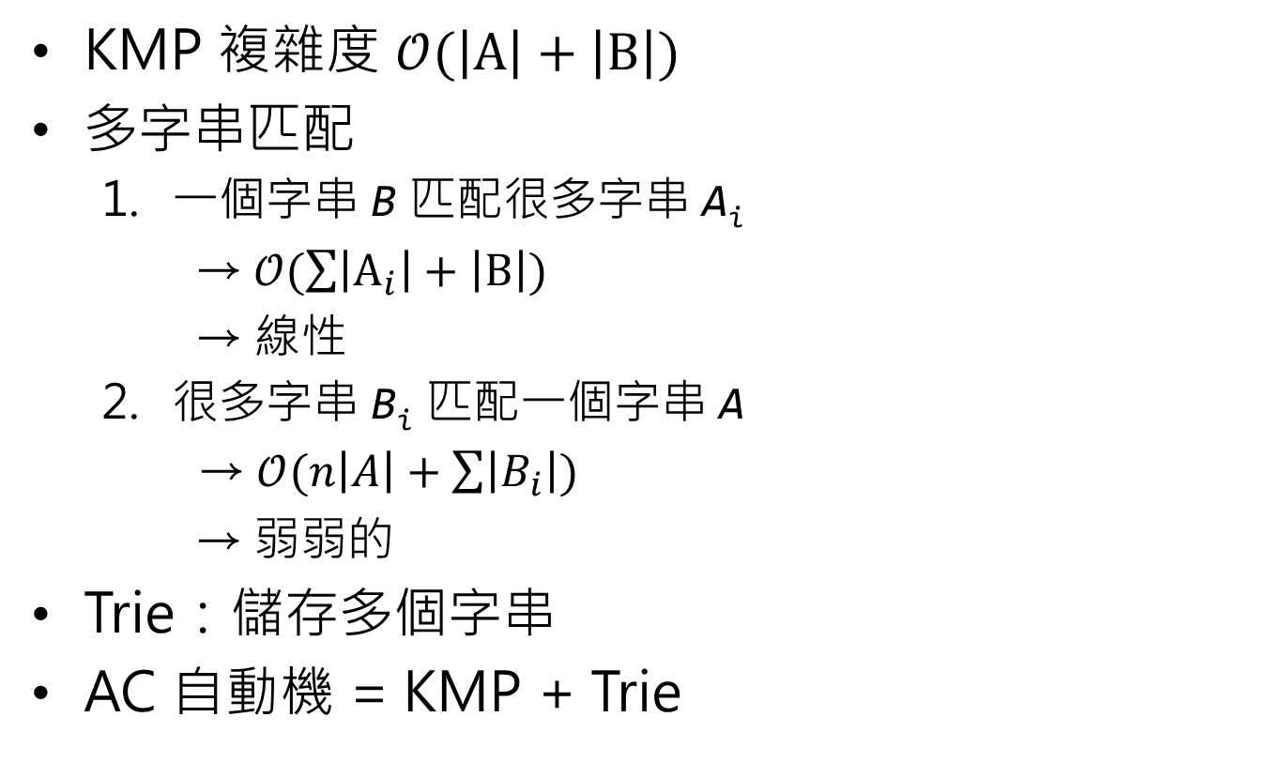
AC Automaton
KMP 複雜度 $𝒪(\left|A\right|+\left|B\right|)$
多字串匹配
一個字串 B 匹配很多字串 A_{i}
→ $𝒪(\sum{\left|A_{i}\right|}+\left|B\right|)$
→ 線性
很多字串 B_{i} 匹配一個字串 A
→ $𝒪(n\left|A\right|+\sum{\left|B_{i}\right|})$
→ 弱弱的
Trie：儲存多個字串
AC 自動機 = KMP + Trie

Slide 80
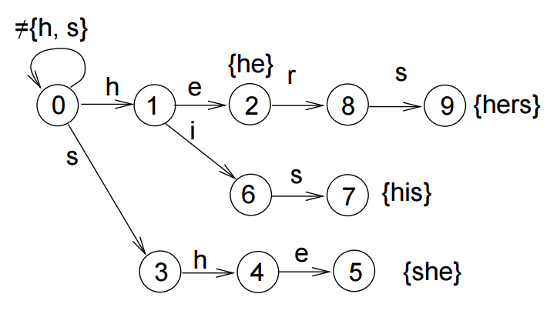
AC Automaton
KMP 複雜度 $𝒪(\left|A\right|+\left|B\right|)$
多字串匹配
一個字串 B 匹配很多字串 A_{i}
→ $𝒪(\sum{\left|A_{i}\right|}+\left|B\right|)$
→ 線性
很多字串 B_{i} 匹配一個字串 A
→ $𝒪(n\left|A\right|+\sum{\left|B_{i}\right|})$
→ 弱弱的
Trie：儲存多個字串
AC 自動機 = KMP + Trie

Slide 81
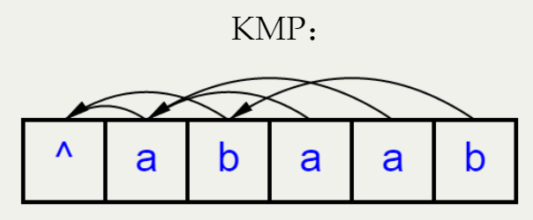
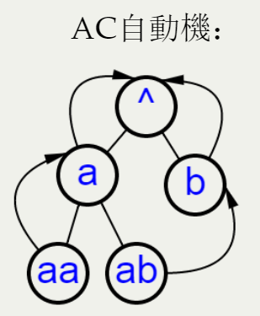
AC Automaton
比較 Fail function (圖)

Slide 82
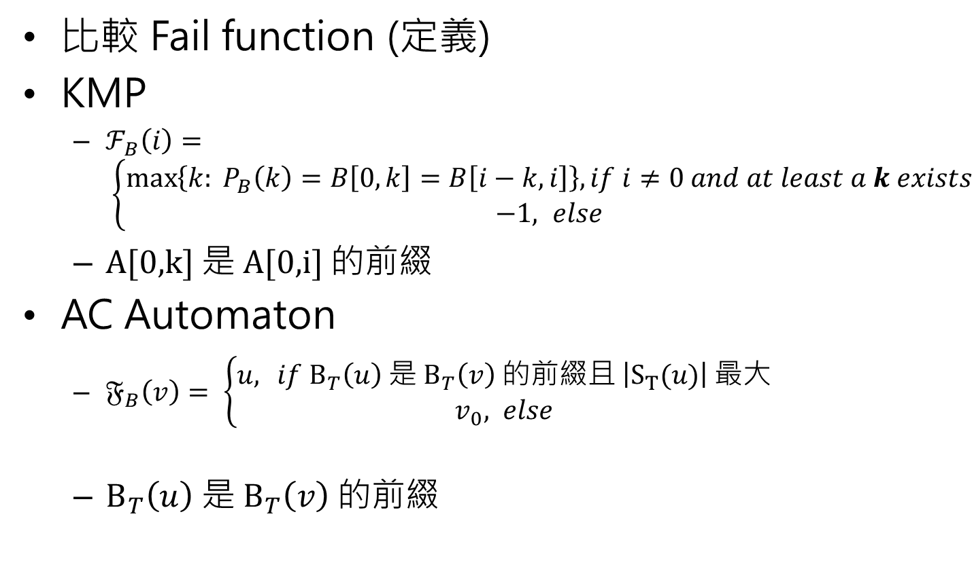
AC Automaton
比較 Fail function (定義)
KMP
$ℱ_{B}\left(i\right)= \left\{\begin{aligned}\max\left\{k: P_{B}\left(k\right)=B\left[0,k\right]=B\left[i−k,i\right]\right\}, if i≠0 and at least a k exists \\ −1, else\end{aligned}\right.$
A[0,k] 是 A[0,i] 的前綴
AC Automaton
$𝔉_{B}\left(v\right)= \left\{\begin{aligned}u,{ if B_{T}\left(u\right) 是 B_{T}\left(v\right) 的前綴且 \left|S_{T}(u)\right| 最大} \\ v_{0}, else\end{aligned}\right.$
$B_{T}\left(u\right) 是 B_{T}\left(v\right) 的前綴$

Slide 83

AC Automaton
比較 Fail function (匹配失敗)
KMP
沿著 $ℱ\left(i\right), ℱ^{2}\left(i\right)$, … 嘗試，直到 $ℱ^{t}\left(i\right)=−1$
AC Automaton
沿著 $𝔉\left(v\right), 𝔉^{2}\left(v\right)$, … 嘗試，直到 $𝔉^{t}\left(v\right)=v_{0} (v_{0}:root)$

Slide 84

AC Automaton
比較 Fail function (構造)
KMP
利用 $ℱ\left(i−1\right)$ 求出 $ℱ\left(i\right)$
AC Automaton
利用 $𝔉\left(u\right)$ 求出 $𝔉\left(v\right)$，u 為 v 的父節點
use BFS

Slide 85
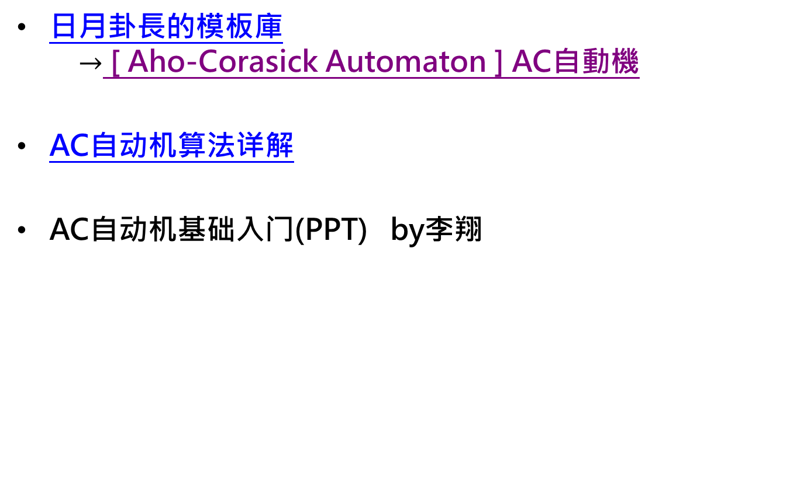
Automaton – 範例 code
日月卦長的模板庫 $→$ [ Aho-Corasick Automaton ] AC自動機
AC自动机算法详解
AC自动机基础入门(PPT) by李翔

Slide 86
Automaton – 例題
AC Automaton
SPOJ NSUBSTR 題解
SPOJ SUBLEX 題解
Codeforces 235C 題解
這些都是作法很多 ( Suffix Array, Suffix Tree... )，非常經典的問題，可以從中理解 SAM 的精妙之處
UVa 10679, 1449

Slide 87
Reference
歷屆PPT…… (electron, free999, louis6340, …)
2015 IOI camp 字串處理 http://ioicamp.csie.org/content http://bobogei81123.github.io/ioi-lecture

